Slide 1




Business Management for IT
(IT3090)
Introduction to Management
(Lesson 1)

Slide 2

Module Introduction
Business Management for IT
Code :IT3090.
Maintenance of subject files - PPT, Extra readings, newspaper/magazine articles, quizzes, pass papers, model answers
Attendance: Compulsory
Lecturer contact details: Geethma.p@sliit.lk/ Didula.c@sliit.lk

Slide 3
Module Outline
 | Topic
1 | Introduction to Management
2 | The Basics of Management
3 | Managing people
4 | Accounting for business
5 | Sources of Finance
6 | Analysis of Business Environment (Internal & External)
7. | Introduction to Economics

Slide 4
Module Outline
 | Topic
8 | Managing Revenue
9 | Revision

Slide 5

Assessments
Continuous Assessments
Quiz(Week 8) 20%
End Semester Assessment
Final Examination 80%

Slide 6

Class Rules
Be on time.
Attend all lecture sessions.
Mobile phones must remain switched off during class.
Ask questions. Make use of office hours.
Do your homework. Study regularly.

Slide 7
Learning Outcomes
At the end of the session students will be able to;
Understand nature of a business organization
Understand key problem associated with any business organization
Understand the need for management
Types and Forms of business

Slide 8



Business Organization
A business organization is a, group of people working together to satisfy human needs and wants by producing goods and services with a common objective of profit maximization.

Slide 9
Goal Directed Behavior???
List goals of a business organization.
1……………………………………………………………………………
2……………………………………………………………………………
3……………………………………………………………………………
4……………………………………………………………………………
5……………………………………………………………………………
6……………………………………………………………………………

Slide 10



Productive Resources
Operating cost
Land
Entrepreneurship
Labor
Capital
OC: Cost of acquiring and using the four productive resources

Slide 11
Business Functions; buy, make, sell, trade
Buy/acquire
Make/Process
Sell or Trade
Labor
Material
Capital
Technology
Equipment and machineries
Knowledge and information etc
Warehouse
Production and operations
Marketing
Financing and accounting
Human resource management etc
Research and development (R&D)
Selling and distribution
Exchange, trade of goods and services

Slide 12
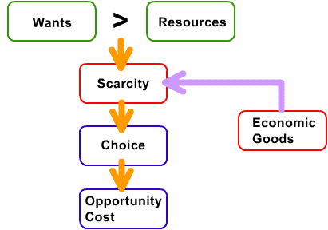
What is the basic economic problem ?

Slide 13
Why study management?
Universality of management
The reality of work
The rewards and challenges of being a manager.

Slide 14

What Is Management?
The art of getting things done through people.
The process of,
Planning, Organizing, Leading and Controlling the work of the organization members and using all available organizational resources to reach stated organizational goals, efficiently and effectively in an ever changing business environment.
Coordinating work activities so that they are completed efficiently and effectively with and through other people (Robbins & Coulter, 2005).

Slide 15
The Process of Management
0
Planning
Select goals and ways to attain them
Resources
Performance
Human
Financial
Raw Materials
Technological
Information
Attain goals
Products
Services
Efficiency
Effectiveness
Controlling
Organizing
Monitor activities and make corrections
Assign responsibility for task accomplishment
Leading
Use influence to motivate employees

Slide 16

Who Are Managers?
Someone who coordinates and oversees the
work of other people so that organizational
goals can be accomplished.

Slide 17
Types of Managers/ Levels of Management
First-line managers
Middle managers
Top managers

Slide 18
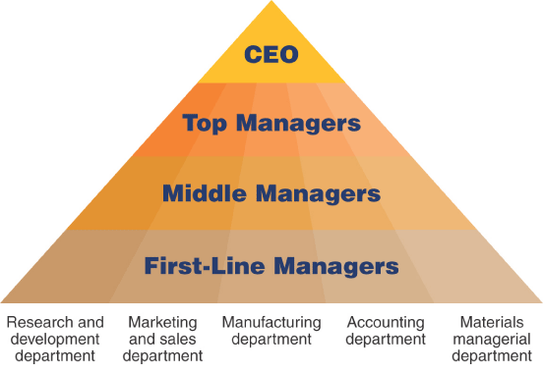
Types of Managers/ Levels of Management

Slide 19

Types Business Organizations
Service providing business organizations
Manufacturing organizations
Trading organizations

Slide 20
Principal forms of business organizations
Sole proprietorship
Partnerships
Companies
Non-profit making organizations

Slide 21
Sole Proprietorships
The most simple and common form of business.
Owned and control by an individual.
The law basically treats the business and the owner as one and the same ( no legal personality).
Personally liable for all debts or losses (unlimited liability).
The business carried on its’ own name.

Slide 22

Sole proprietorships
Advantages ???
Disadvantages???

Slide 23

Partnerships
A partnership is an agreement between two or more persons to operate a business(2-20)
Partners should formulate an agreement to make decisions on:
- How profits and losses are to be shared among the partners.
- How much money they should invest to the business
- Their responsibilities in the management
No legal personality

Slide 24
Partners are personally liable for business debts (unlimited liability)
Partnership dissolves when a partner dies or the expiration of the specified time period.
Widely used for small businesses and professional practices
Advantages???
Disadvantages???

Slide 25

Companies
Companies limited by shares
Companies limited by guarantee
Companies with unlimited liability

Slide 26
Limited Companies
These organizations should incorporate under the ‘Companies Act no 07 of 2007’.
The liability of the shareholders of a corporation is limited to the amount of their capital contribution
The Company has a separate legal personality
The Companies can raise more funds
Separation of ownership and management
Perpetual life

Slide 27
Types of Limited Companies
Limited Companies
Private Limited Companies
Public Limited Companies

Slide 28
Private Limited Companies
Maximum 50 shareholders and should consist at least one director
No shares can be offered for sale to the general public
Consent of all shareholders is required to transfer shares to a new shareholder
Not allowed to raise funds by issuing debentures
The last two words of the name should be read as either “(Private) Limited” or “(Pvt) Ltd”

Slide 29
Public Limited Companies
No limit to the maximum number of shareholders and should consist at least two directors.
Can offer shares for sale to the general public
No restriction on the transferability of shares, if listed in the CSE.
Allowed to raise funds by issuing debentures
The last word of the name should be read as either as “Public Limited Company” or “PLC” if the company is a listed company. If not the name should be as “Limited” or (‘LTD’)

Slide 30
Advantages ???
Disadvantages ???

Slide 31
Thank you and Good Luck with your Studies

